Slide 1
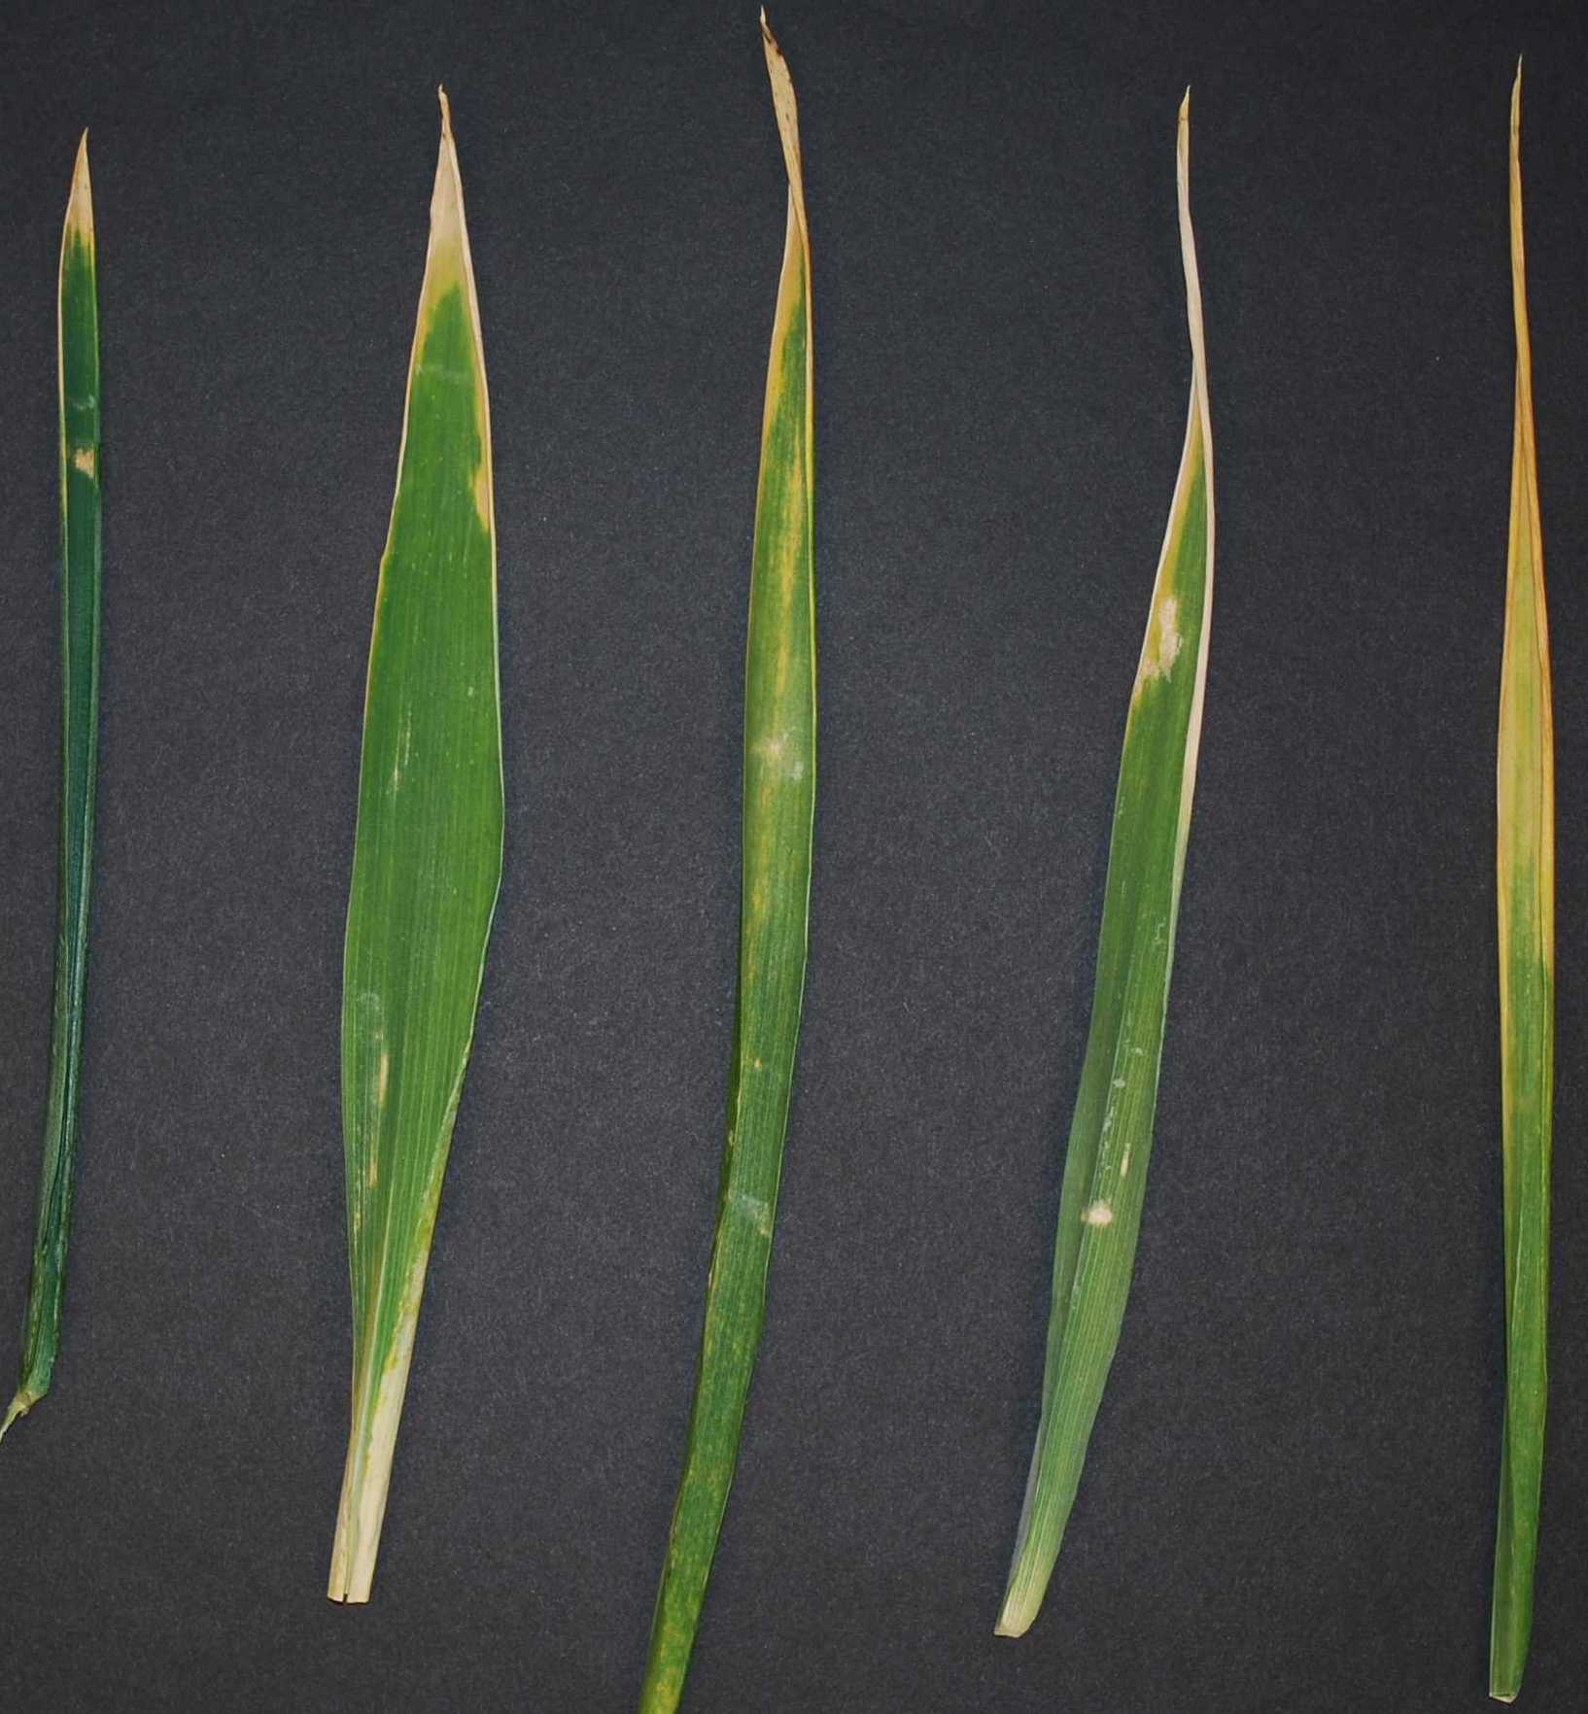
WHEAT FLAG LEAF SENESCENCE SCORING OF PRIMARY TILLER - SCORED ONCE >2.5CM AT TIP OF FLAG LEAF IS YELLOWED
NO YES YES YES YES

